Slide 1
AB Testing
by Abirami S
CB.EN.U4CSE20202

Slide 2
Dataset : Reliance Stock Price
Gender of Customer along with the purchased amount in the supermarket
Hypothesis
Null Hypothesis (H0) : Male and Female customer Avg total are same.
Alternate Hypothesis (Ha) : Male average total is less that female.

Slide 3
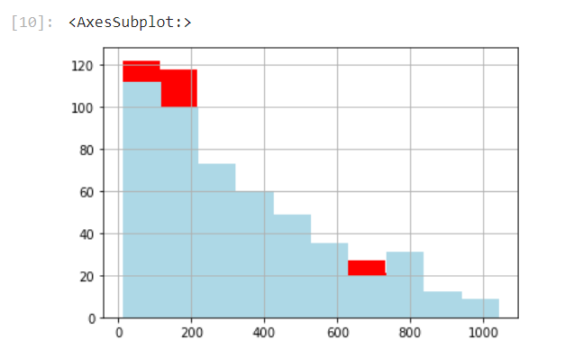
Histogram
red : Male
blue : Female

Slide 4
Analysis
The test statistic is the difference in the average total.
The observed test statistic is 24.3
When a random sample is simulated using permutation the differences observed are plotted along with the observed difference for each data.

Slide 5
Conclusion
Since from the plot it is obvious that the observed statistic is within the histogram
The empirical P value is 0.9416 greater than the significance level, hence it too supports the Null hypothesis.
Therefore, we cannot reject the null hypothesis
Thus, proving that Male and Female customers average total is almost the same.

